Slide 1
1강
목차
Linux 환경에서 Python 실습 (https://docs.python.org/ko/3/tutorial/appetite.html) 추가연습예제: https://app.codility.com/programmers/lessons/1-iterations/ 유튜브 : https://youtu.be/kWiCuklohdY
프로그래밍 환경 ( pycharm, git, github ) 및 test, dev, operation 이해
개발환경 의사선택
마무리 및 소통

Slide 2
Python 프로그래밍 기본
변수 선언
데이터 타입 number, string, list, tuple, dictionary
A_list = [ horse, dog, rabbit ]
A_list[0] -> horse
A_list[0] = horse
A_tuple = ( cat, dog, rabbit )
A_tubple[1] -> cat
A_dict = { ”david” : [horse, cat], “jaepa” : dog }
A_dict[”david”] -> horse
조건문 if, elif, else
Condition = 2>1 = true
Num = 2
If num ==1 :
print(“hello”)
Elif num ==2:
print(“bye”)
Else:
print(“mmm”)
루핑테크닝 for, while, continue, break
함수선언
Class선언

Slide 3
Python 프로그래밍 기본
루핑테크닝 for, while, continue, break
A = [ horse, dog, rabbit ]
A[0] * 2, a[1] *2, a[2]*2
For id in A:
print(id */% // ** 2)
함수선언
Class선언

Slide 4
git
Aws cloud
Jaepa local
Andy local
test
operation
Mother drone AI
git
dev
git
github
David local
JX_code
Child drone AI
Situation space
Child drone
Mother drone
Child drone

Slide 5
Window os
GUI
Easy to use
Linux os
CLI
Easy to Admin
tensorflow
pytorch
Visualcode
Free to remote
Pycharm
Good to debug
LiDAR
Vision
python
cpp
Stereo vision
Mono vision

Slide 6
2강
목차
0. 복습 및 신기한것 (bin파일(cat), rm –rf * )
1. Git 설치및 활용
2. Python 환경구성(https://nadocoding.tistory.com/4), 예제풀이(https://wikidocs.net/7021)
3. deep learning의 기술 흐름, papers with code -> sota ( state of the art )
-Alexnet(convolution),
Vggnet(convolution with 3x3 filter),
resent(relu, gradient,),
Xceptionnet(경량화),
Transformer(all you need is attention),
vision transformer()

Slide 7
Git 회원가입
레포지터리 생성
Python 설치
Visual studio code 설치
연습문제
Git push

Slide 8

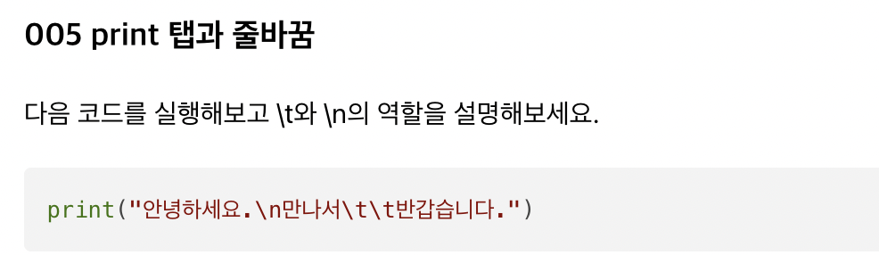
복습

Slide 9
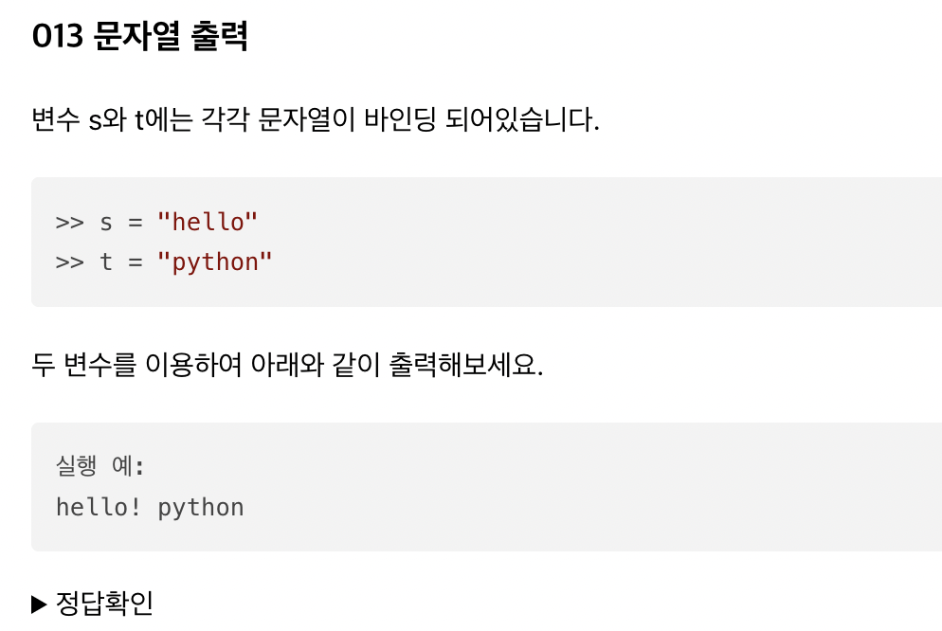
복습

Slide 10
복습

Slide 11
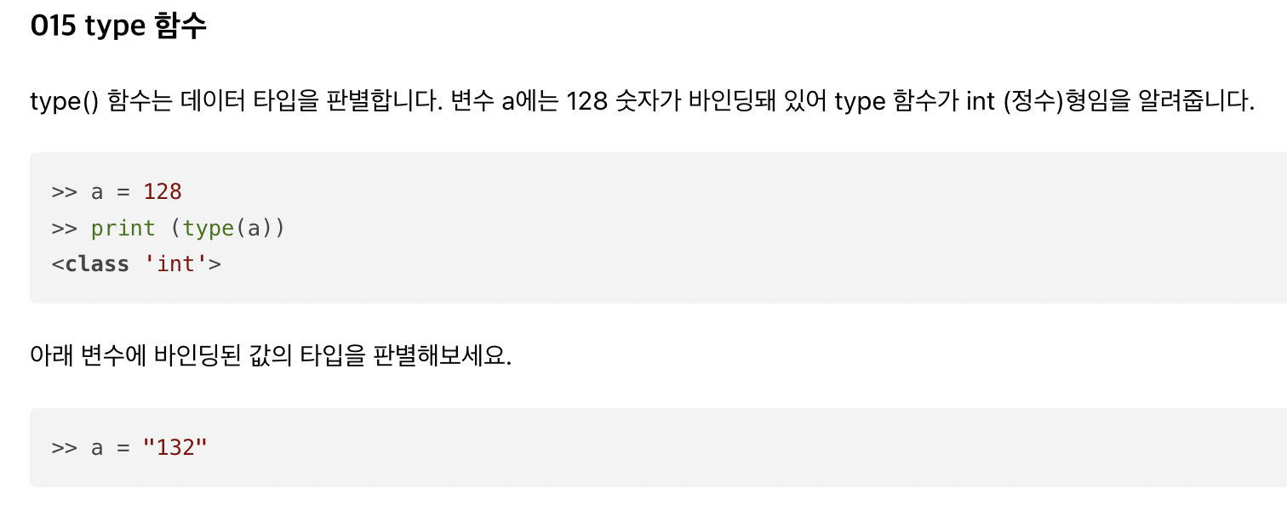
복습

Slide 12
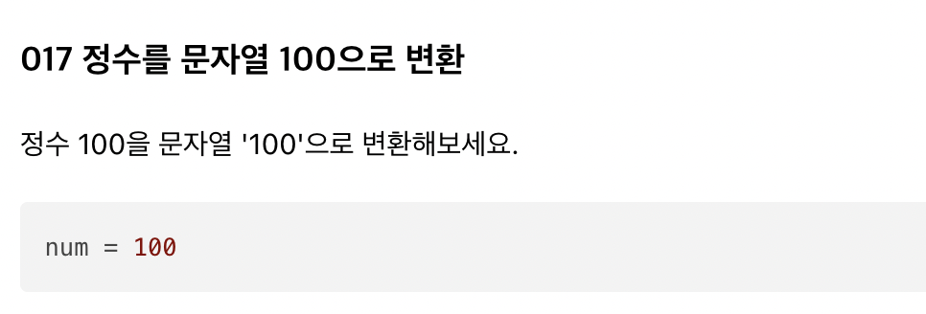
복습

Slide 13
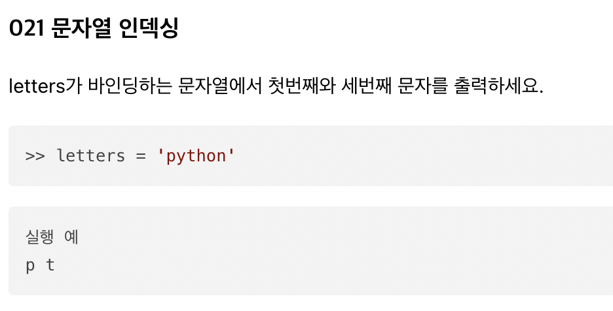
복습

Slide 14
Python 환경설정(https://nadocoding.tistory.com/4), 예제풀이(https://wikidocs.net/7021),

Slide 15
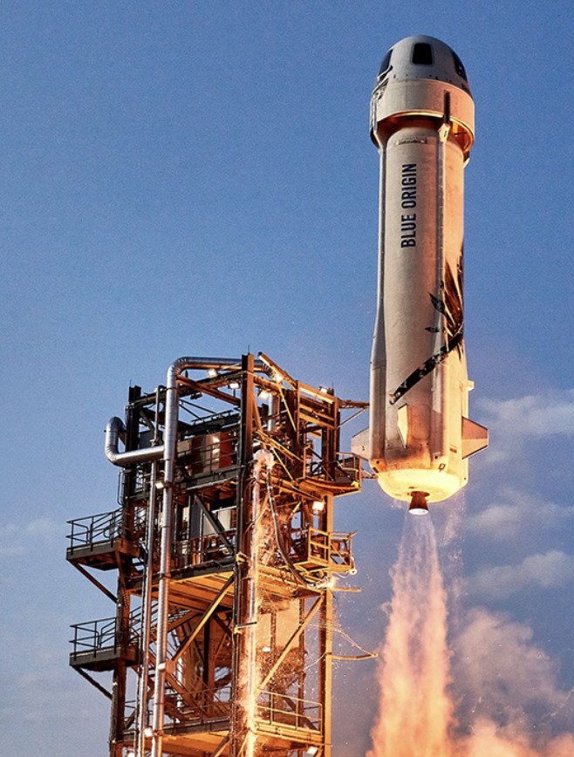
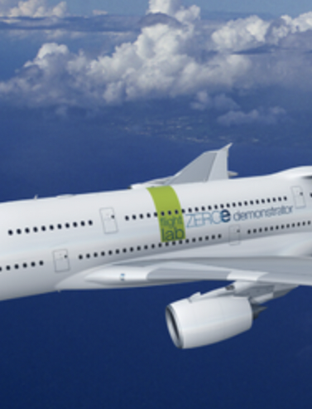
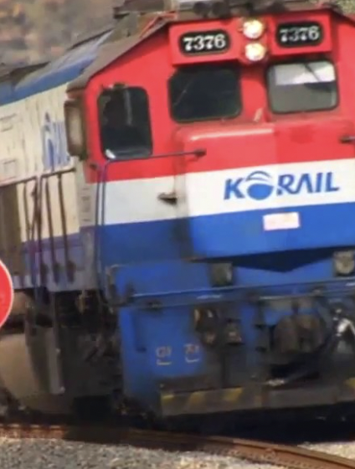
우주선, 비행기, 기차의 특징을 프로그래밍 할수 있을까?

Slide 16
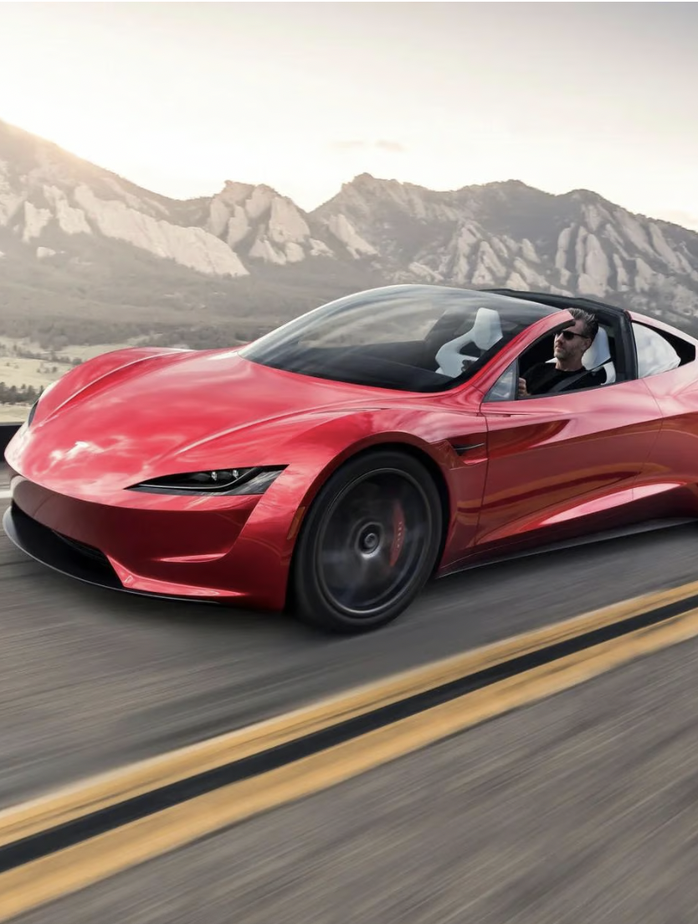
자동차가 추가 된다면?

Slide 17
ImageNet Large Scale Visual Recognition Challenge (ILSVRC)
Alexnet(convolution),
Vggnet(convolution with 3x3 filter),
resent(relu, gradient,),
Xceptionnet(경량화),
Transformer(all you need is attention),
vision transformer()

